Slide 1

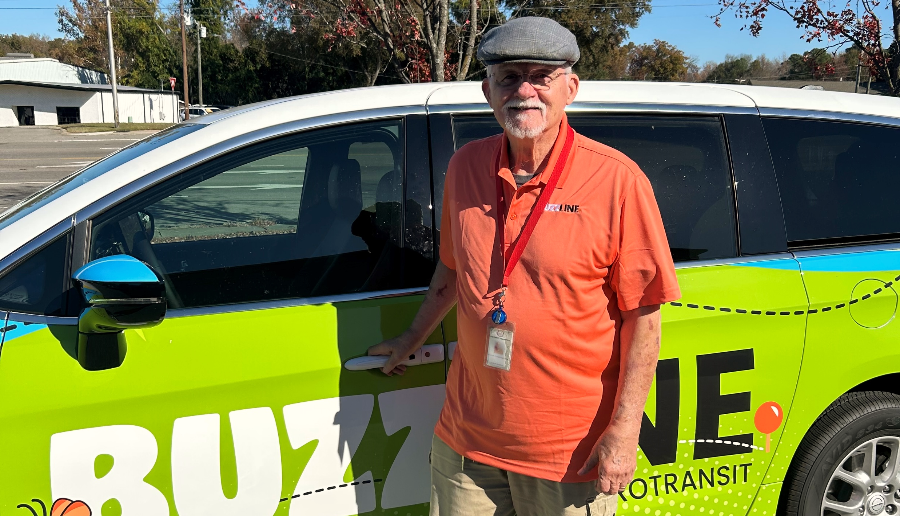
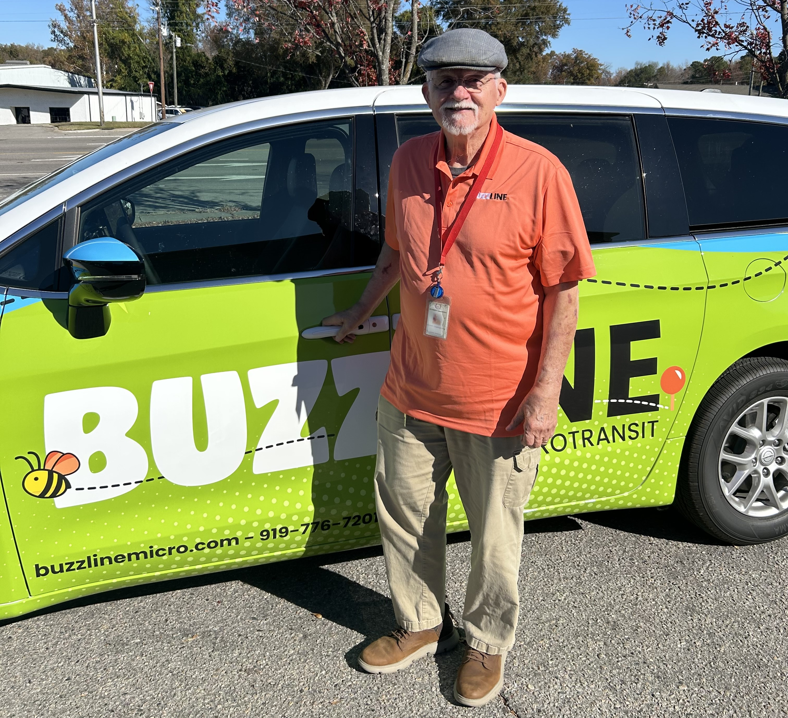
INTEGRATED MOBILITY DIVISION
Last Updated: 03/05/2026
PUBLIC TRANSPORTATION
FUNDING
SOURCES
OVERVIEW
FY28

Slide 2
PUBLIC TRANSPORTATION
INTEGRATED MOBILITY DIVISION
Unified Grant Application Guidance
1 UGA Guidance Overview
2 How to Access the UGA Guidance
3 New to FY28

Slide 3
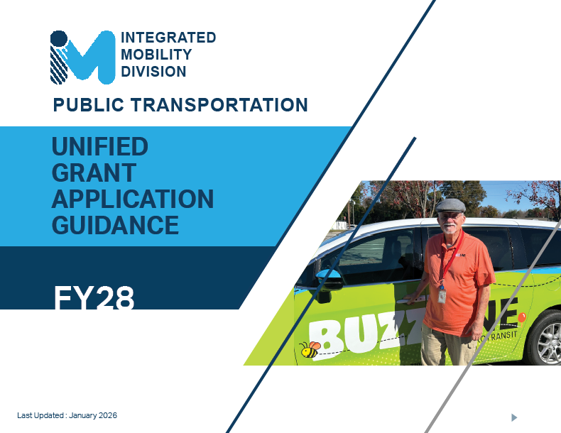
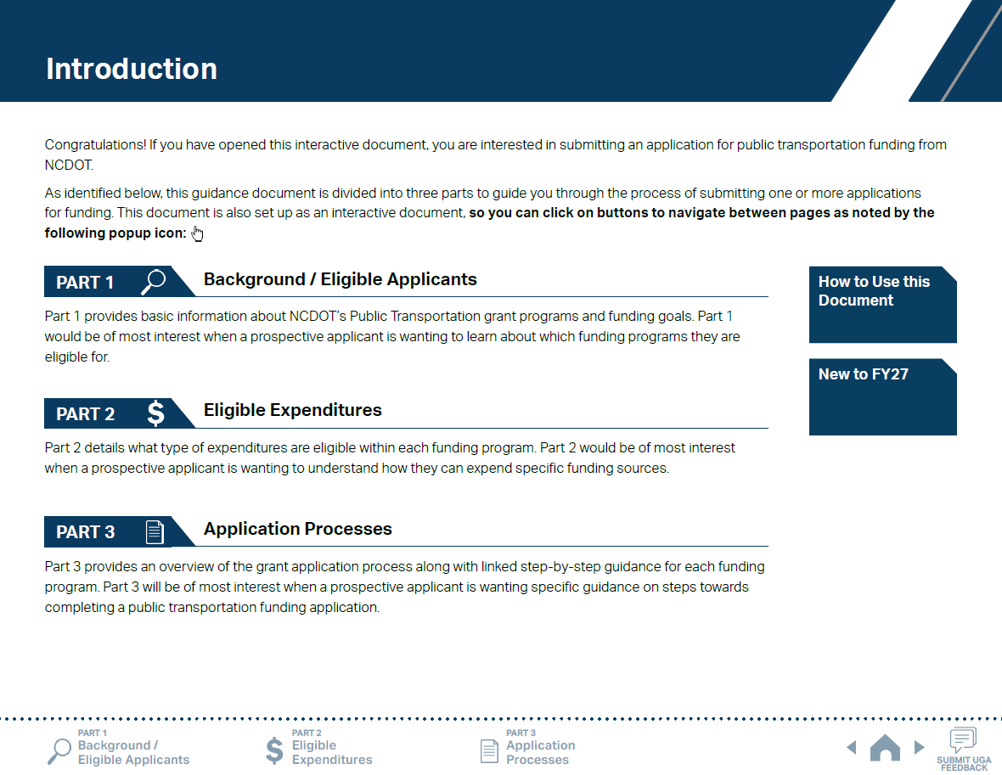
ncdot.gov
1 UGA Guidance Overview
Notes:
Unified Grant Application is a new platform for guidance and instruction for the submittal of all public transportation grants, except specific ones such as TDM.
UGA Guidance consists of three parts just like this training material: Background/Eligible Applicants; Eligible Expenditures; and Application Processes. You will find the same information in the UGA Guidance.

Slide 4
ncdot.gov
1 UGA Guidance Overview
What is the UGA?
The UGA is an acronym for Unified Grant Application which is a consolidated application process for nearly all transit-related grants offered through the Integrated Mobility Division (IMD).
What it Covers
The UGA Guidance document is structured into three major parts:
Part 1 – Background and Eligibility: Who can apply and what program exist.
Part 2 – Eligible Expenditures: What types of costs can be funded
Part 3 – Application Process: Step-by-step instructions for completing each program’s application
UGA Process (3 Phases)
Pre-Application: Provide preliminary documentation.
Application: Complete detailed program applications in the EBS system.
Contracting and Compliance: Agreements, compliance materials, procurement, and reporting requirements.

Slide 5
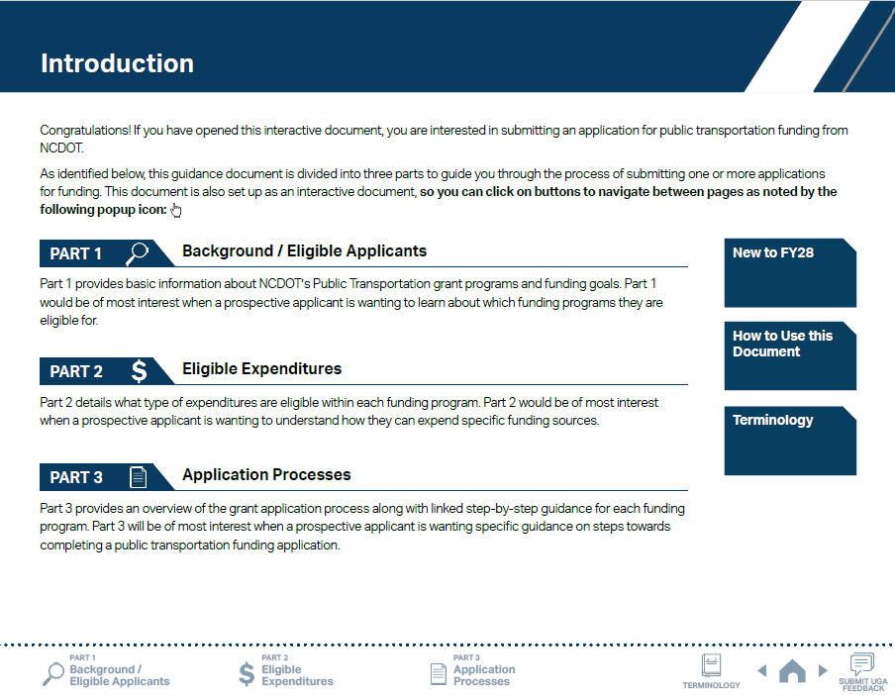
ncdot.gov
1 UGA Guidance Overview
1
Click on icons to navigate to each part of the UGA.

Slide 6
ncdot.gov
1 UGA Guidance Overview
1
Click on icons to navigate to each part of the UGA.
2
Use navigation buttons to view previous/next pages.

Slide 7
ncdot.gov
1 UGA Guidance Overview
1
Click on icons to navigate to each part of the UGA.
2
Use navigation buttons to view previous/next pages.
3
Use the survey button to leave feedback.

Slide 8
ncdot.gov
1 UGA Guidance Overview
1
Click on icons to navigate to each part of the UGA.
2
Use navigation buttons to view previous/next pages.
3
Use the survey button to leave feedback.
4
New terminology button linking to all UGA term
definitions.

Slide 9
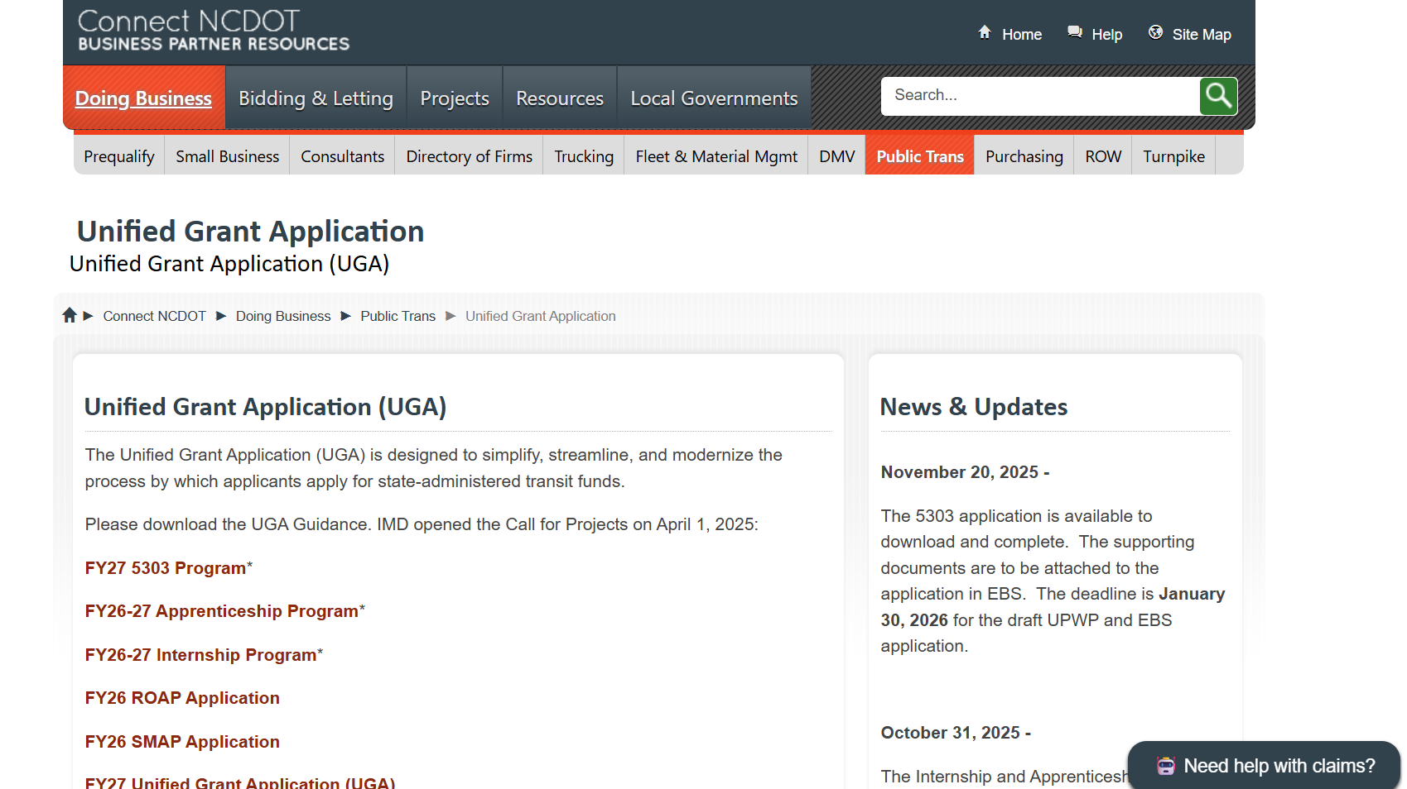
ncdot.gov
2 How to Access the UGA Guidance
https://connect.ncdot.gov/business/Transit/Pages/Unified-Grant-Application.aspx
Notes:
UGA Guidance can be accessed through Connect NCDOT website

Slide 10
ncdot.gov
3 New to FY28
UGA Guidance Updates
Added FY28 Applicant Profile Smartsheet Form to Application Phase (Phase 2) to minimize duplicated entries of the application profile information over multiple application documents.
As per the interim final rule, references to DBE, MBE, WBE, and EEO have been removed or revised from the document. Refer to EEO Update to acknowledge the change.
The revised EEO Statement and Financial Health Statement have been added to the FY2 Pre-Application Materials Smartsheet form.
Propane conversion kits are added as a separate G-code for ordering through the Combined Capital program.
Public Hearing is no longer required by state and federal regulations, but the public must be informed by other means, i.e., Facebook, Flyers, Notice on Buses.

Slide 11
ncdot.gov
3 New to FY28
UGA Guidance Updates
5311 Designee Certification Form is due for FY28 UGA Application, if applying for 5311.
The marketing fee requirement of 2% is added back into 5311 Admin G-codes G371 and G372.
Information on the IMD Internship/Apprentice Program has been added to Part 1.3 and Part 2.2. Internship/Apprentice Program has a separate application process/timeline.
Instructions on Salary & Wage Detail Report have been added to the appendix and referenced from Step 7 and Step 12 on Part 3.3.
Links to FY28 application submission workspaces for systems are now accessible through a Smartsheet table.
Fully Allocated Cost model and Cost Allocation - TBD
DOT’s Office of Civil Rights’ Unified Certification Program - TBD

Slide 12
ncdot.gov
3 New to FY28
UGA Guidance Updates
The FY29 Future Capital Needs Request Form is no longer a part of the UGA process. IMD will send out a separate request email with instructions.
Sample application document sets are posted on the UGA website for programs applied through the UGA process.
Removed Fax Number entries from program applications.
FTA Circular updates: 9050.1A(Info for 5339 and 5307 are combined into 9050.1A), 4220.1G, and 9040.1H
Reinstituted vehicle insurance cap amount ($4,000)

Slide 13
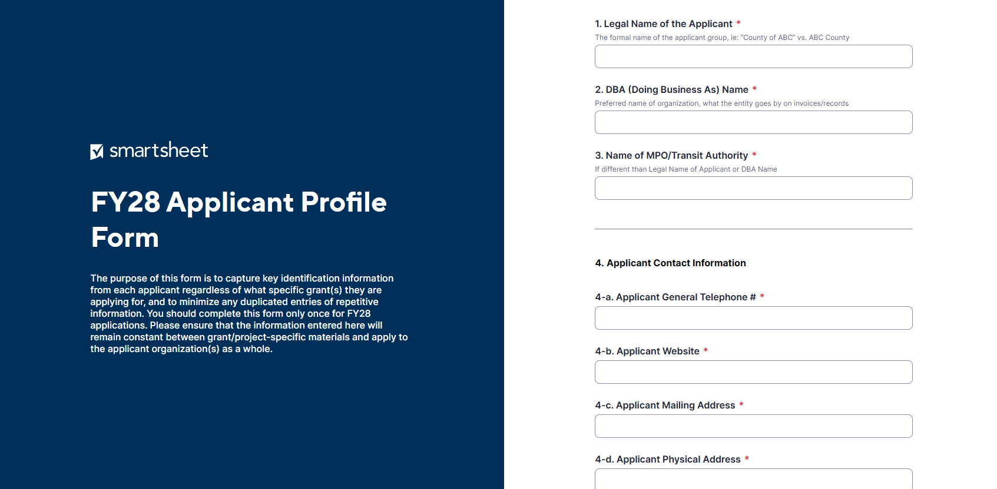
ncdot.gov
3 New to FY28
Application Profile Form
Streamlines the application process by combining recurring questions on application documents.
Example: Applicant Service Area and Applicant Identification Information.

Slide 14
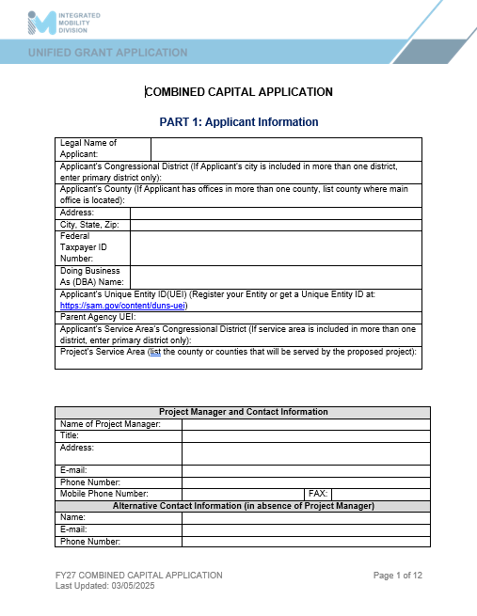
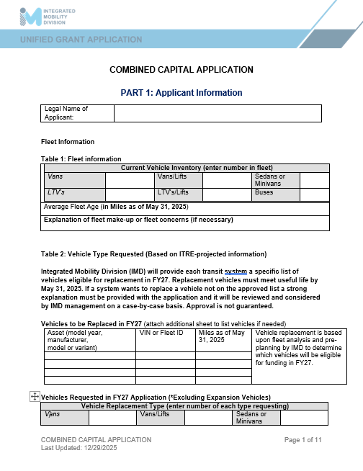
ncdot.gov
3 New to FY28
Application Profile Form
Reference of a FY28 application vs. a FY27 application once the applicant information is extracted and the fax number box is removed.
FY27
FY28

Slide 15
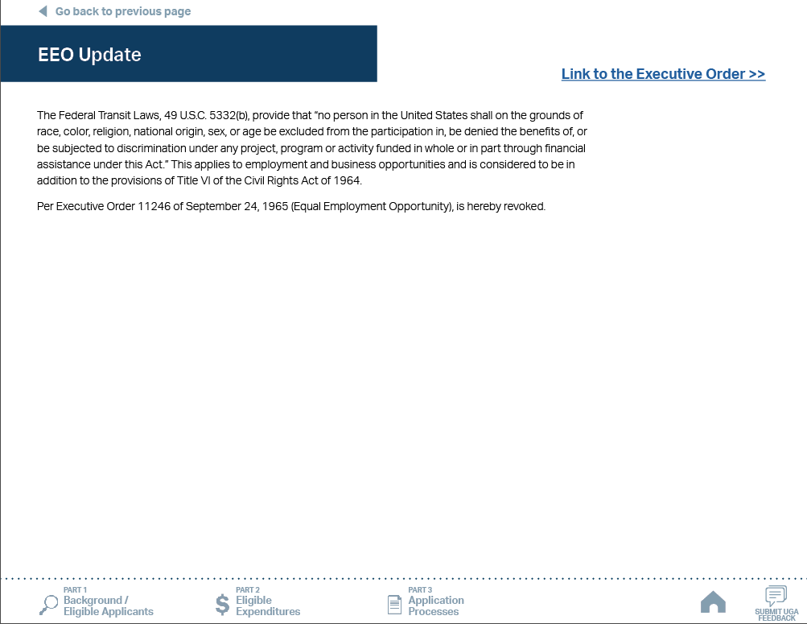
ncdot.gov
3 New to FY28
EEO Update
New EEO Statement per Executive Order 11246.
References to DBE, MBE, WBE, and EEO have been removed or revised from the document

Slide 16
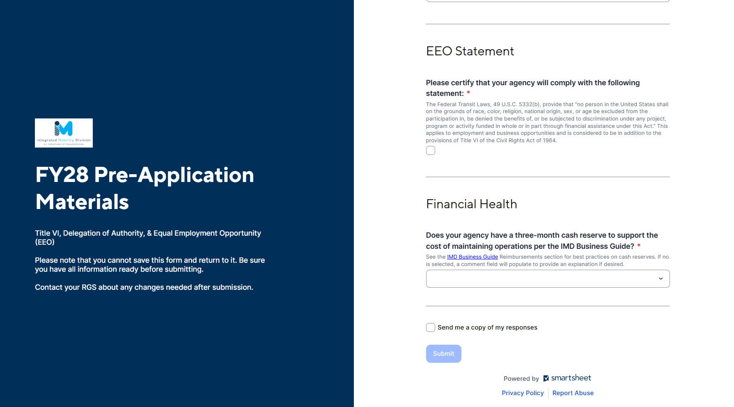
ncdot.gov
3 New to FY28
EEO Statement and Financial Health Statement
Added to Pre-Application Materials form
No form or signature is needed.

Slide 17
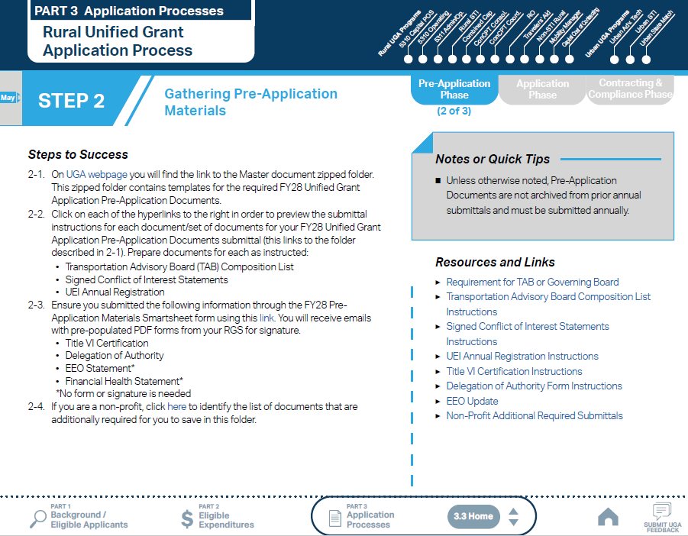
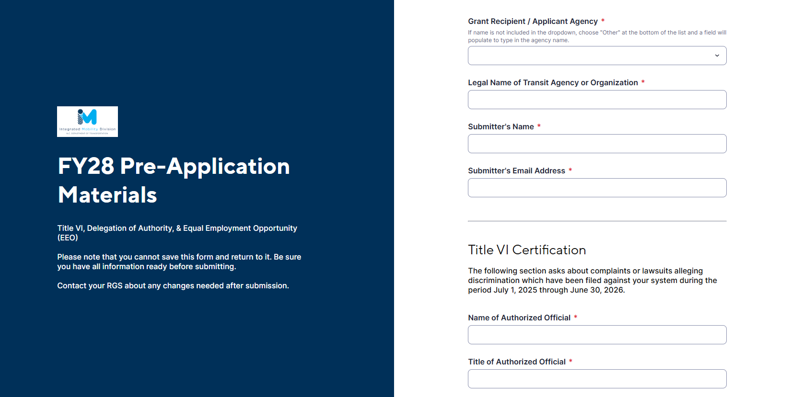
ncdot.gov
3 New to FY28
EEO Statement and Financial Health Statement
Pre-Application Materials form
No form or signature is needed.

Slide 18
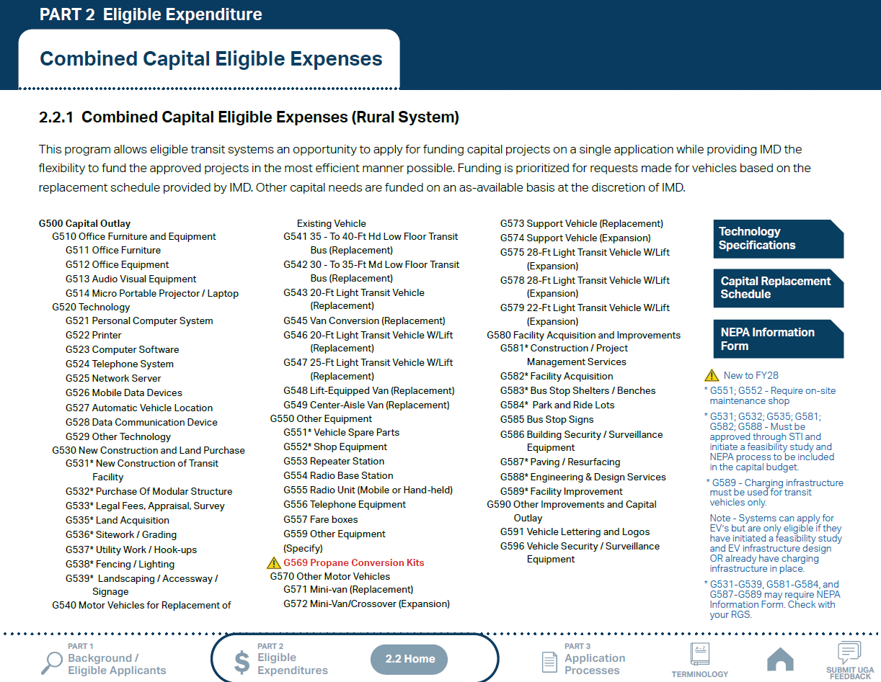
ncdot.gov
3 New to FY28
Propane Conversion Kits
Propane conversion kits will be listed under a separate G‑code when ordered through the Combined Capital program.
Shown with this icon:

Slide 19
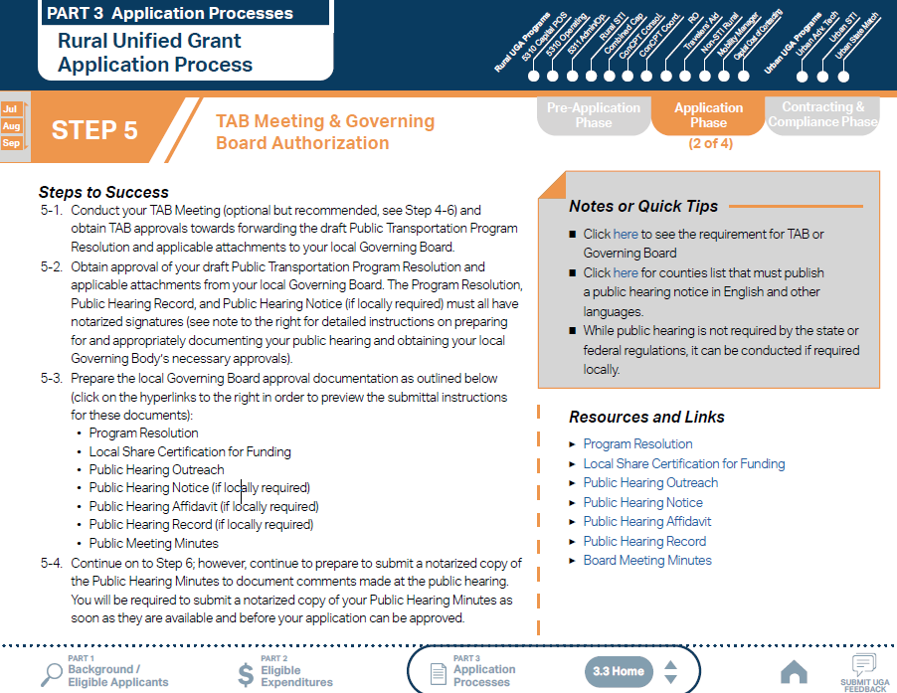
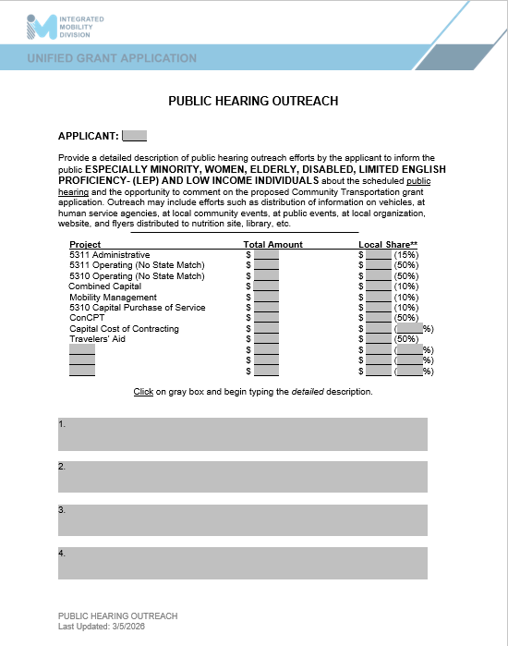
ncdot.gov
3 New to FY28
Public Hearing Notice
Public Hearing Notice is no longer required by state and federal regulations, but the public must be informed by other means ie. Facebook, Flyers, Notice on Buses.

Slide 20
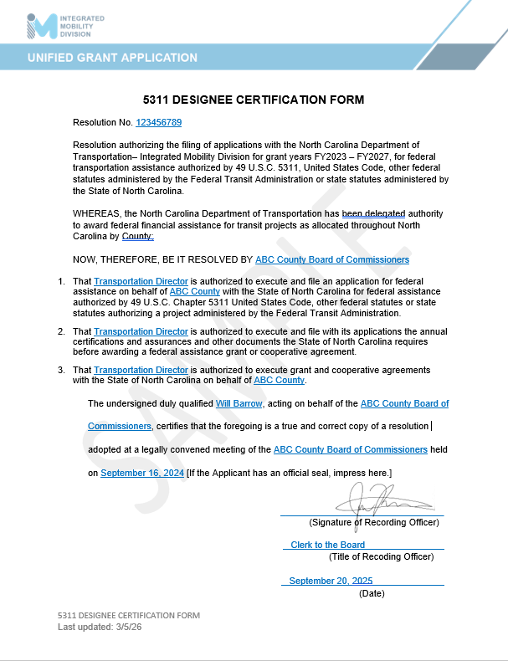
ncdot.gov
3 New to FY28
5311 Designee Certification Form
Due for FY28 applications
Valid for the next 5 years.

Slide 21
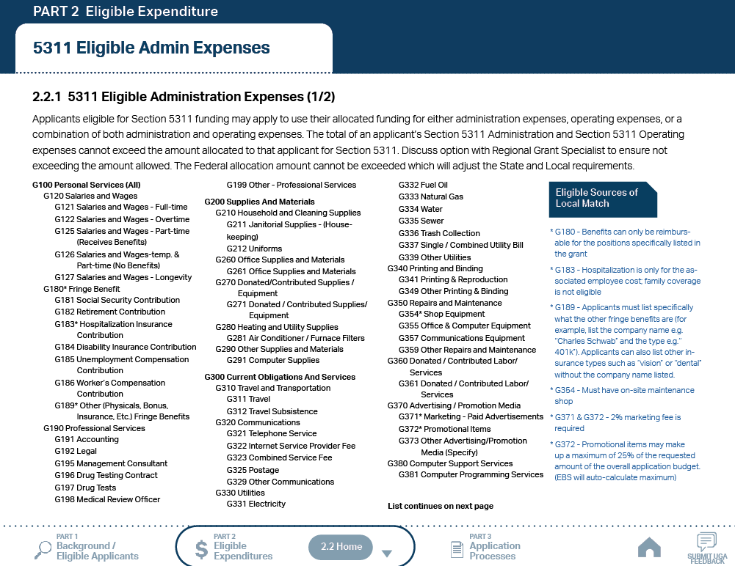
ncdot.gov
3 New to FY28
Marketing Fee
The marketing fee requirement of 2% is added back into 5311 G-codes 371 and G372.

Slide 22
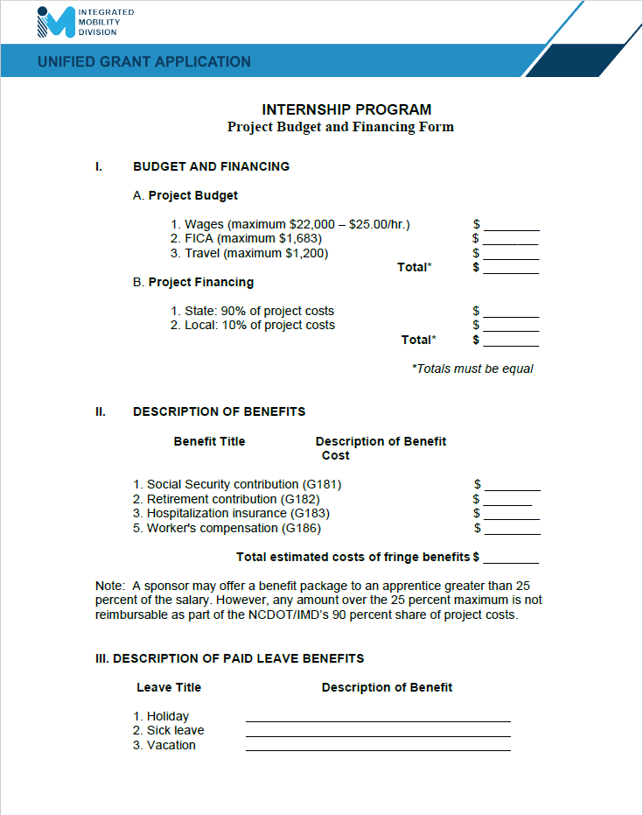
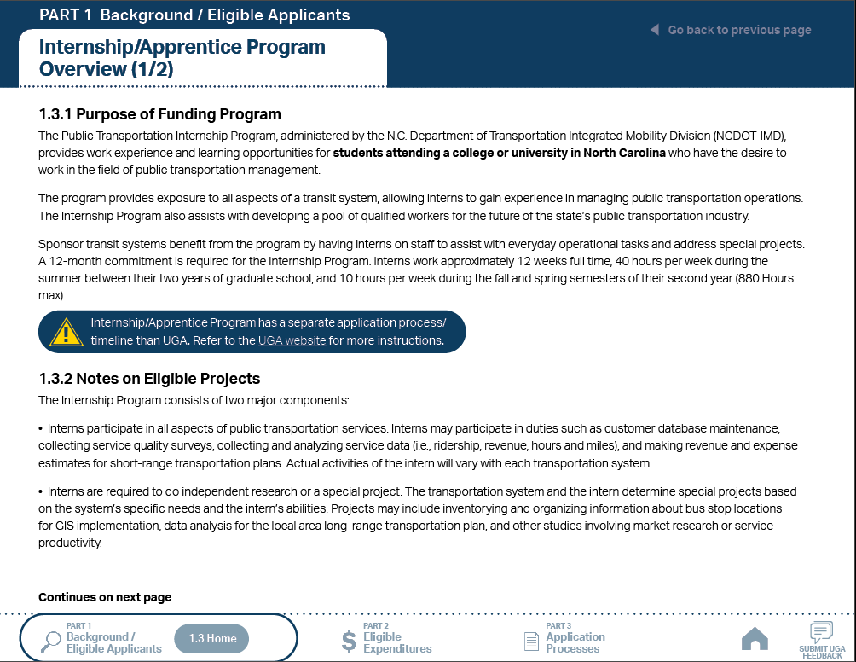
ncdot.gov
3 New to FY28
Internship/Apprentice Program
Added to Part 1.3 and Part 2.2.
Internship/Apprentice Program has a separate application process/timeline.

Slide 23
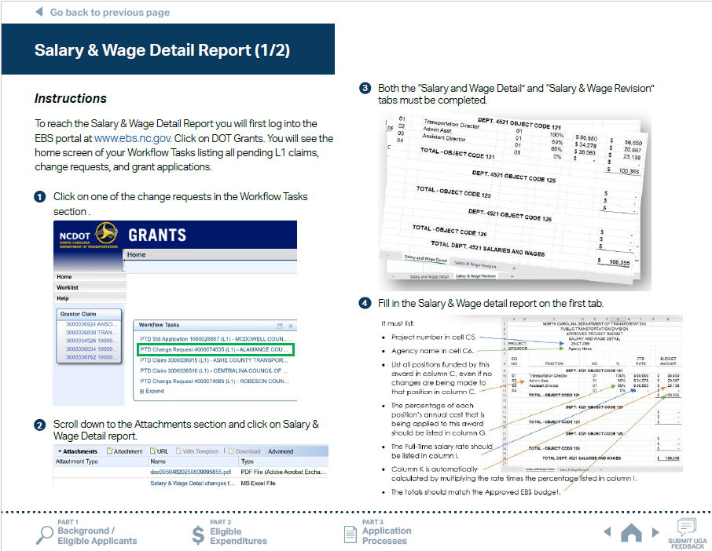
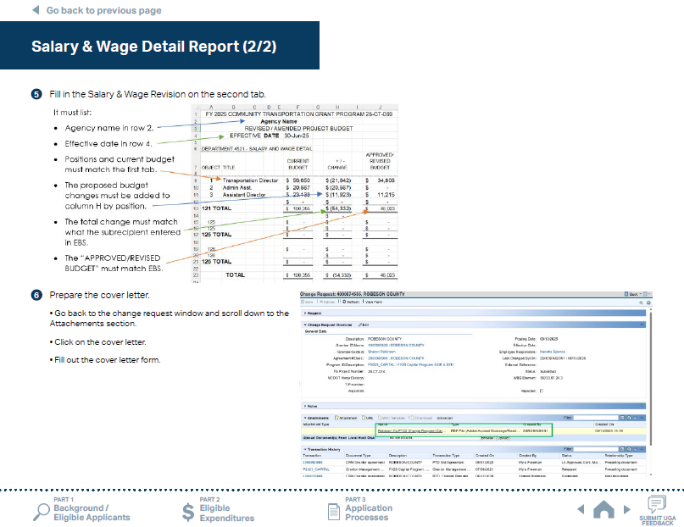
ncdot.gov
3 New to FY28
Salary & Wage Detail Report
Instructions on how to update the Salary & Wage Detail Report in the EBS portal have been added to the appendix.

Slide 24
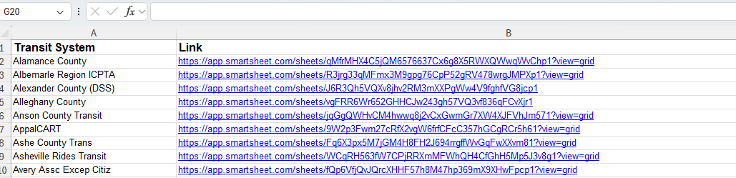
ncdot.gov
3 New to FY28
Links to Application Submission Workspaces
Access to the FY28 application submission workspaces for each transit system will now be available in one Smartsheet table.

Slide 25
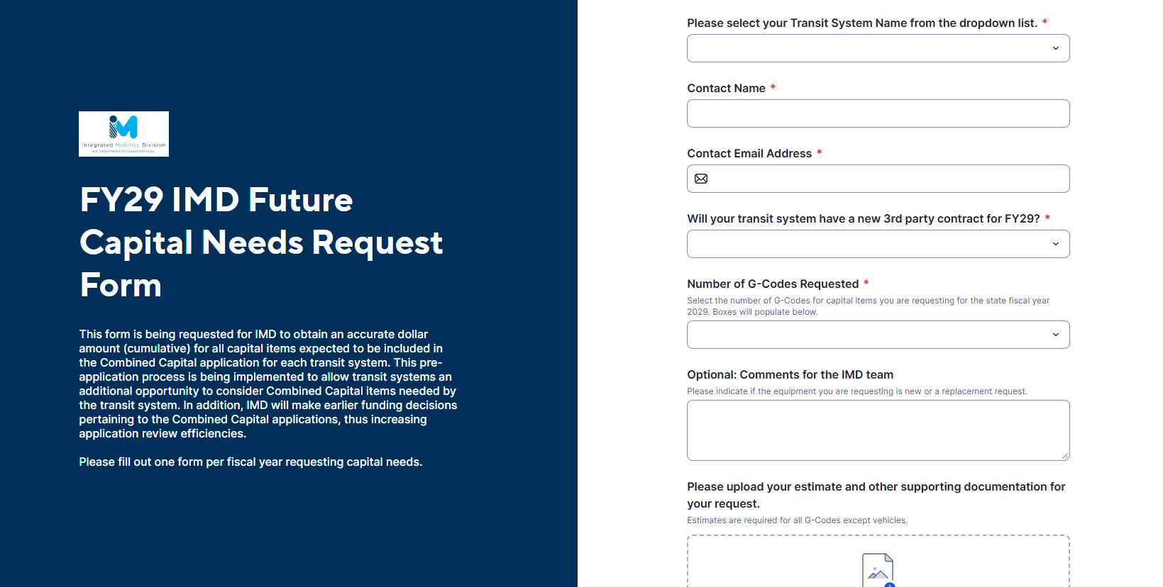
ncdot.gov
3 New to FY28
Future Capital Needs Request Form
The FY29 Future Capital Needs Request Form is no longer a part of the UGA process. IMD will send out a separate request email with instructions.

Slide 26
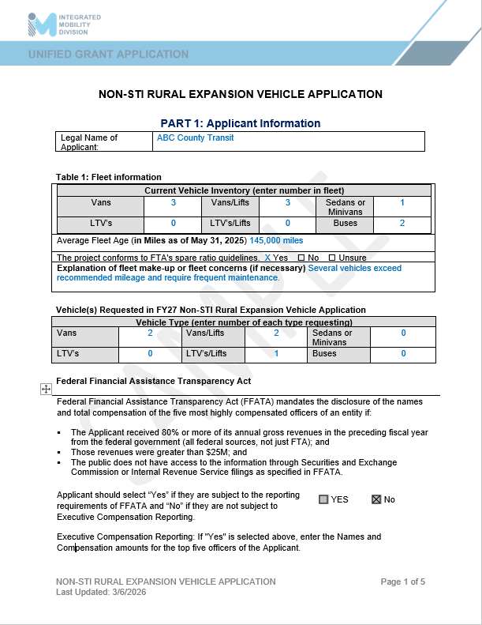
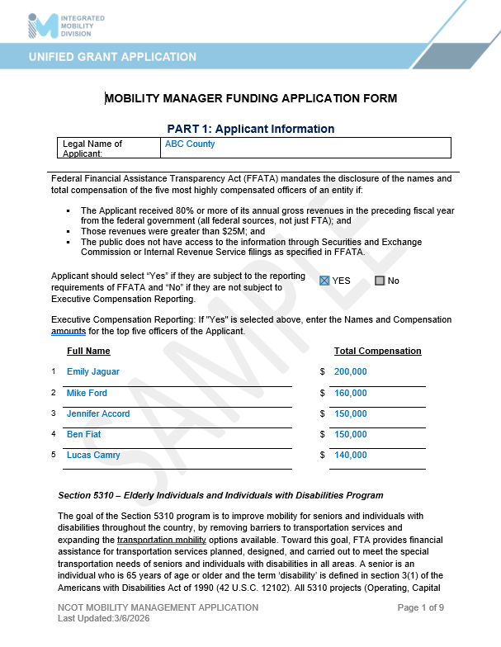
ncdot.gov
3 New to FY28
Sample Applications
Sample application document sets will be posted on the UGA website for programs applied through the UGA process.

Slide 27
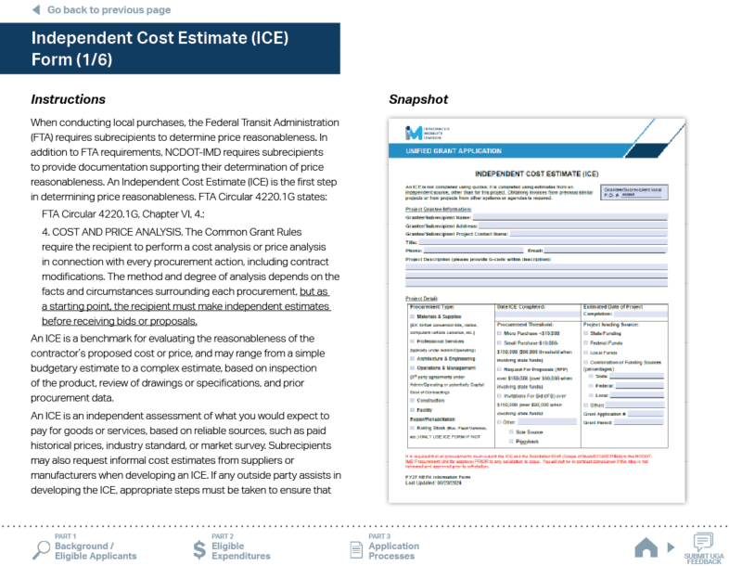











ncdot.gov
3 New to FY28
Circular Updates
Circular 9050.1A consolidates the information previously contained in Circulars 5339 and 5307.
4220.1G (effective Jan 2025) – replaces 4220.1F
9040.1H (effective Nov 2024) – replaces 9040.1G

Slide 28
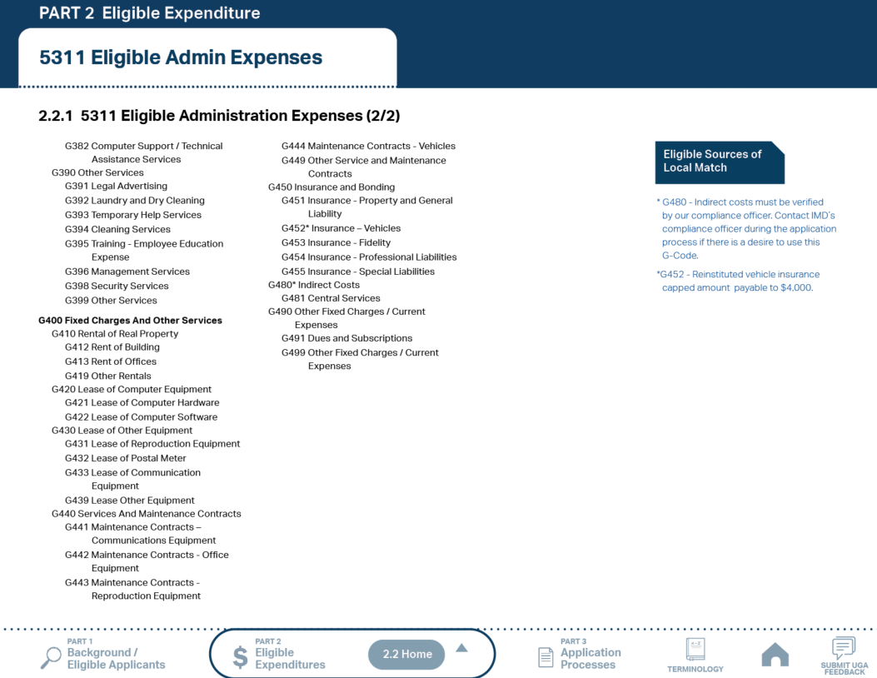
ncdot.gov
3 New to FY28
Reinstituted vehicle insurance
Reinstituted vehicle insurance cap amount to $4,000

Slide 29
ncdot.gov
O
3 New to FY26 and FY27 Refresher
FY27 UGA Updates
FY26 UGA Updates
Added new UGA documents: Capital Needs Request Form, NEPA Information Form, and Independent Cost Estimate (ICE) Form.
Smartsheet Workspaces for previous years are available to view and download for review purposes only.
Urban State Match applications are now only submitted when vehicle(s) are received.
Removed Volunteer Reimbursement from 5310 Operating Program.
The date for requesting vehicle mileage is now May 31st.
Renamed ‘Conflict of Interest Policy’ to ‘Signed Conflict of Interest Statements’.
New color scheme for Part 3.3 phases.
Added notes to the Public Hearing Notice and 5310 Capital Purchase of Service.
Consolidated application steps in Part 3.3 programs and grouped into Rural and Urban.
Removed Master Documents required for Urban grants with exception of Travelers’ Aid and ConCPT grants.
Created a UGA Roadmap
No cap on vehicle insurance amount (previously $2,500)
Emphasized that sub-recipients can skip the Pre-Application Phase if they have already applied for another grant during the same fiscal year.
Added new UGA Tools and Resources
  - Smartsheet Quick Reference Guide
  - UGA Video Training Materials
  - UGA Progress Sheet

Slide 30
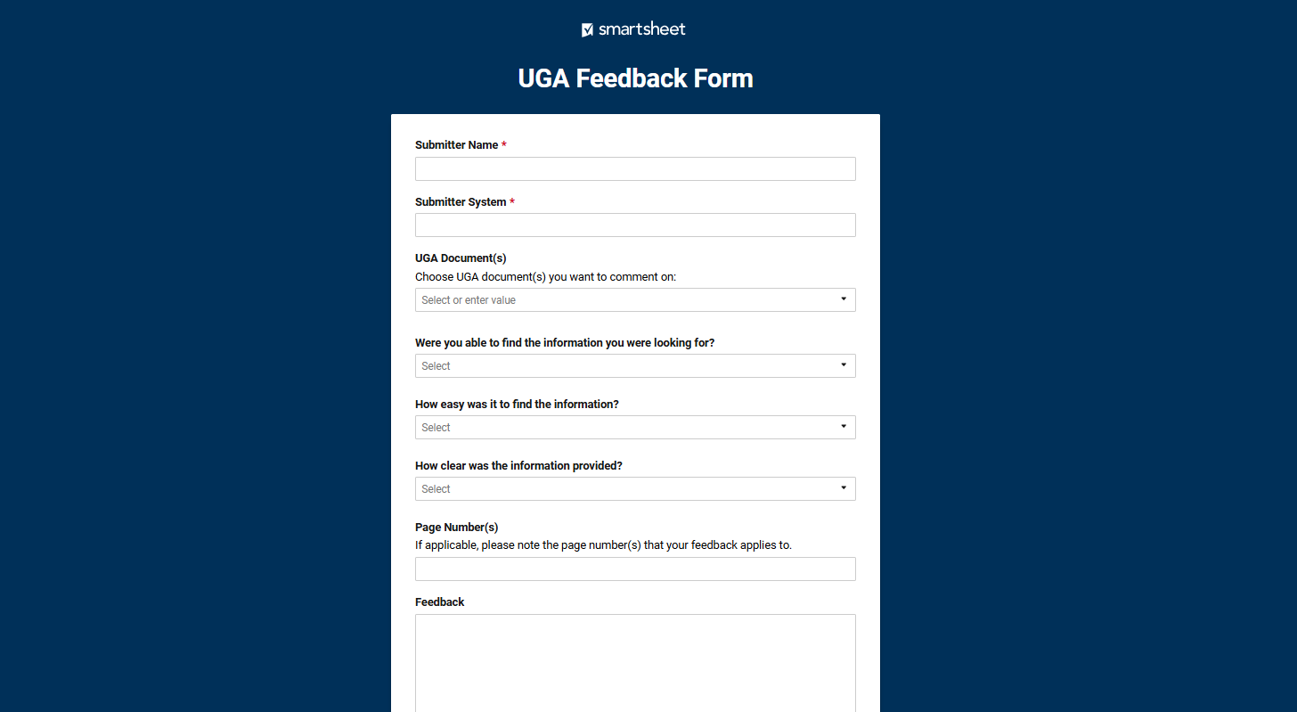
ncdot.gov
3.6 Final Notes
Please provide feedback through the UGA feedback form

Slide 31

ncdot.gov
O
Questions?
Carolyn M. Freitag
Grants Administration Manager
Integrated Mobility Division
919-707-4676
cmfreitag@ncdot.gov
Kenetta Spence
Deputy Director of Finance and Grant Administration
Integrated Mobility Division
(919) 707-4673
kmspence1@ncdot.gov
Casondra L. Hamilton
Business Officer II
Public Transportation Division
919-707-2600
clhamilton@ncdot.gov
Notes:
Questions?

